Slide 1
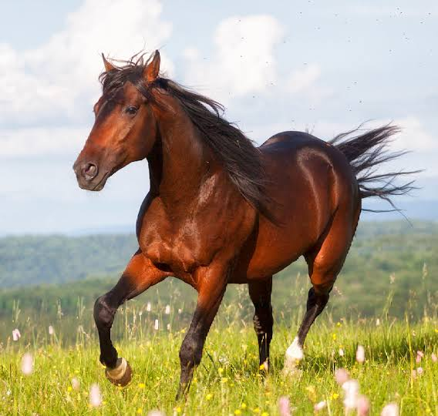
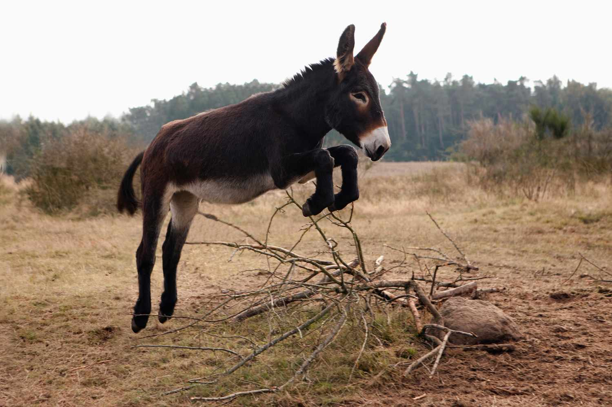
How to Duplicate Our Business
1. Right Selection – Whom will you put your money for winning a race

Slide 2
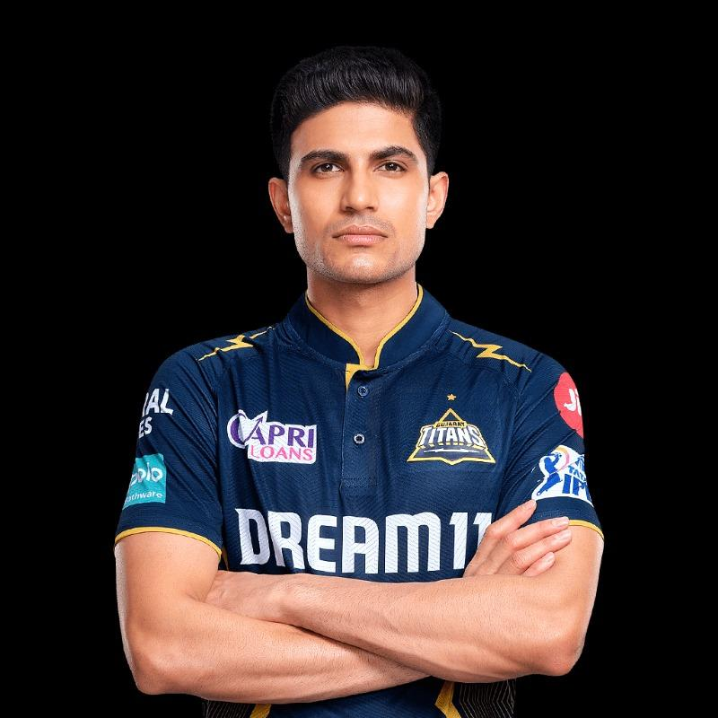
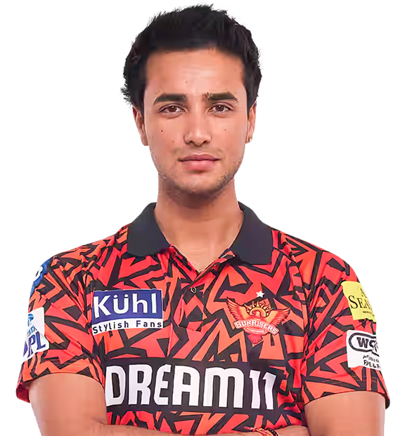
How to Duplicate Our Business
Right Selection – Whom will you put your money for scoring more runs
in next ipl tournament

Slide 3
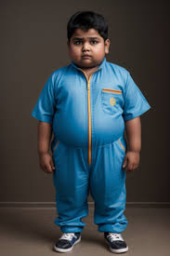

How to Duplicate Our Business
Right Selection – Whom will you put your money to win a long jump

Slide 4
How to Duplicate Our Business
Right Selection – Every profession requires some personality traits to
achieve consistent results.
- Some of the traits I look for in a person to get consistent results
in our industry
Age – 25 to 55 (People have responsibilities in this age, so urge to have
additional income source is still there)
People in this age have a primary source of income so they generally
tend to take their own monetary decisions.
Should be highly unsatisfied with present income/nature of work or both &
be in the looking zone/ open to opportunities.

Slide 5
How to Duplicate Our Business
Preferably an outgoing nature, who likes to meet & talk to people.
I prefer people from sales background or professionals who deal with
people & are comfortable with traveling.
Must be in the income range of 25k – 1 lakh pm.
Willingness to learn & Change.
A good prospect can be leaders from the same industry. But mind your level
while talking to someone. For example if your income is Rs 10,000 pm do not
prospect a leader from different company with an income of Rs 50,000 &
much more experience in the industry than you. Everyone has a silent ego.
Sachin Tendulkar would not like to become subordinate of Vaibhav
Suryavanshi however talented he is.

Slide 6
How to Duplicate Our Business
Education is always an added advantage.
Focus where the company is focusing. Tier 1 & Tire 2 cities. Where personal relations still matter, people have more time & money than their metro counterparts & opportunities are comparatively less than in metros.
Sponsor where there is infrastructure/support of the company & system available.
Sponsor where you can personally travel & nurture the leadership as & when required.

Slide 7
How to Duplicate Our Business
Preferably an outgoing nature, who likes to meet & talk to people.
I prefer people from sales background or professionals who deal with
people, are open to travel.
Must have a primary source of income. Income category 25k – 1 lakh pm.
Willingness to learn & Change.
A good prospect can be leaders from the same industry. But mind your level
while talking to someone. For example if your income is Rs 10,000 pm do not
prospect a leader from different company with an income of Rs 50,000 &
much more experience in the industry than you. Everyone has a silent ego.
Sachin Tendulkar would not like to become subordinate of Vaibhav
Suryavanshi however talented he is.

Slide 8
How to Duplicate Our Business
Right Education/ Skill development – When talent is provided with right
coaching it can achieve its full potential.
Some of the ways for right duplication are
Be a good student of the system you want to promote to others. Walk the talk.
Always keep the system ahead of yourself. All good leaders always believe & deliver one thing; organization is always bigger than a person.
That is the only way to build legacy.
Conduct weekly PASE workshops regularly in your LOS.

Slide 9
How to Duplicate Our Business
Conduct weekly PASE workshops in your LOS. PASE meeting is the manufacturing facility of leadership in the industry. Agenda of PASE workshop must be on the following lines.
Plan Presentation (Business & Health) on board by new recruits. Tool distribution for STP to new recruits.
Product demonstration by new recruits. Demo kit distribution to new recruits.
Objection handling session by a mix of leaders & new recruits
Live calling & inviting session for STP & CEO meeting
Highlighting learnings from books & CEP pre decided to be read/heard that week
Function promotion & ticket promotion demo by leadership
Cold contacting demo by leadership

Slide 10
How to Duplicate Our Business
Conduct weekly PASE workshops in your LOS. PASE meeting is the manufacturing facility of leadership in the industry. Agenda of PASE workshop must be on the following lines.
Plan Presentation (Business & Health) on board by new recruits. Tool distribution for STP to new recruits.
Product demonstration by new recruits. Demo kit distribution to new recruits.
Objection handling session by a mix of leaders & new recruits
Live calling & inviting session for STP & CEO meeting
Highlighting learnings from books & CEP pre decided to be read/heard that week
Function promotion & ticket promotion demo by leadership
Cold contacting demo by leadership

Slide 11
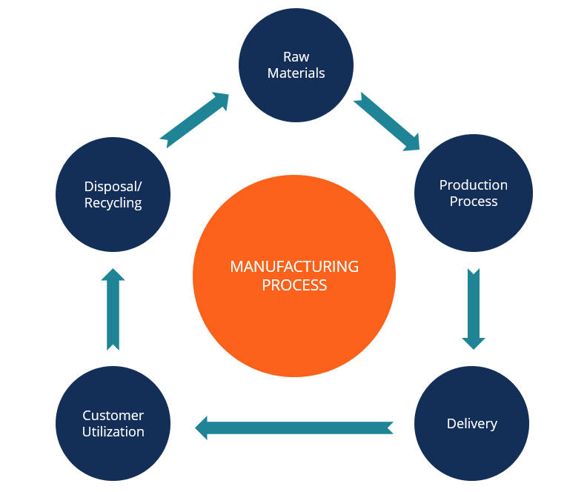
How to Duplicate Our Business
I truly believe direct selling is a business where you get paid to find the
right person, promote & keep him plugged into the system along with you
& then the right person will achieve his full potential.

Slide 12
How to Duplicate Our Business
Thank You

